Slide 1
Client Data Creation and Encryption
Run lock.py
Encryption key is created and saved as secret.key
Run generate_client_data.py
Fake client names and phone numbers generated
secret.key is opened and used to encrypt client data
Platform data selected for each client
Platform data used to select genre preferences for each client
Genre data is semi-randomized
Data is written to data.csv
Data.csv is opened and decrypted with secret.key
Decrypted client data and platform/genre data printed to screen

Slide 2
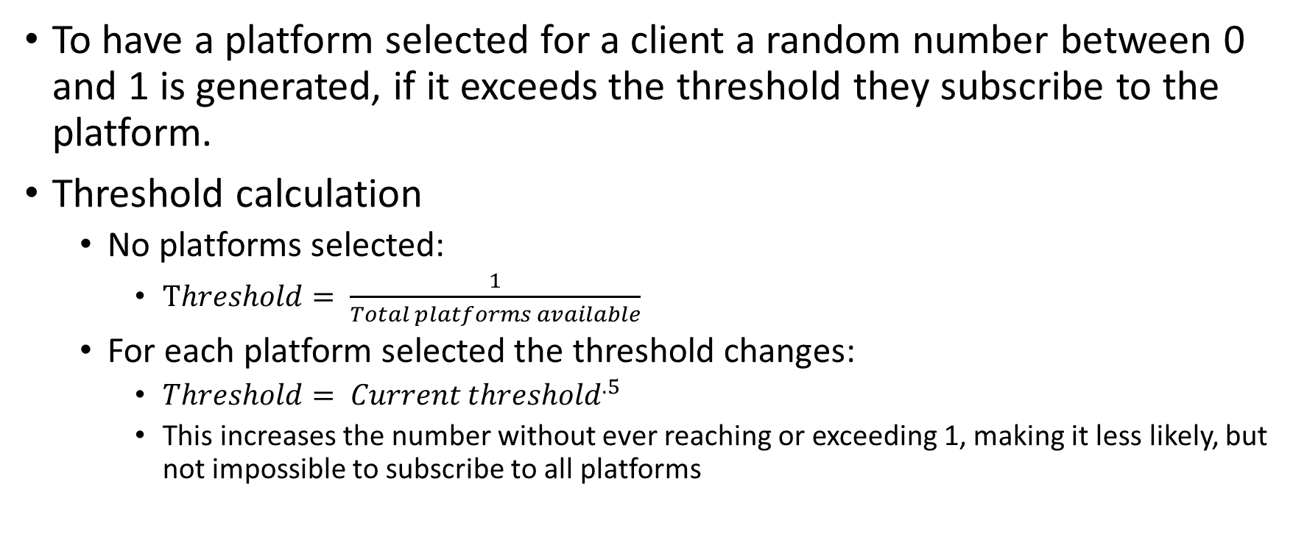
Select platforms
To have a platform selected for a client a random number between 0 and 1 is generated, if it exceeds the threshold they subscribe to the platform.
Threshold calculation
No platforms selected:
$Threshold= \frac{1}{Total platforms available}$
For each platform selected the threshold changes:
$Threshold= {Current threshold}^{.5}$
This increases the number without ever reaching or exceeding 1, making it less likely, but not impossible to subscribe to all platforms

Slide 3
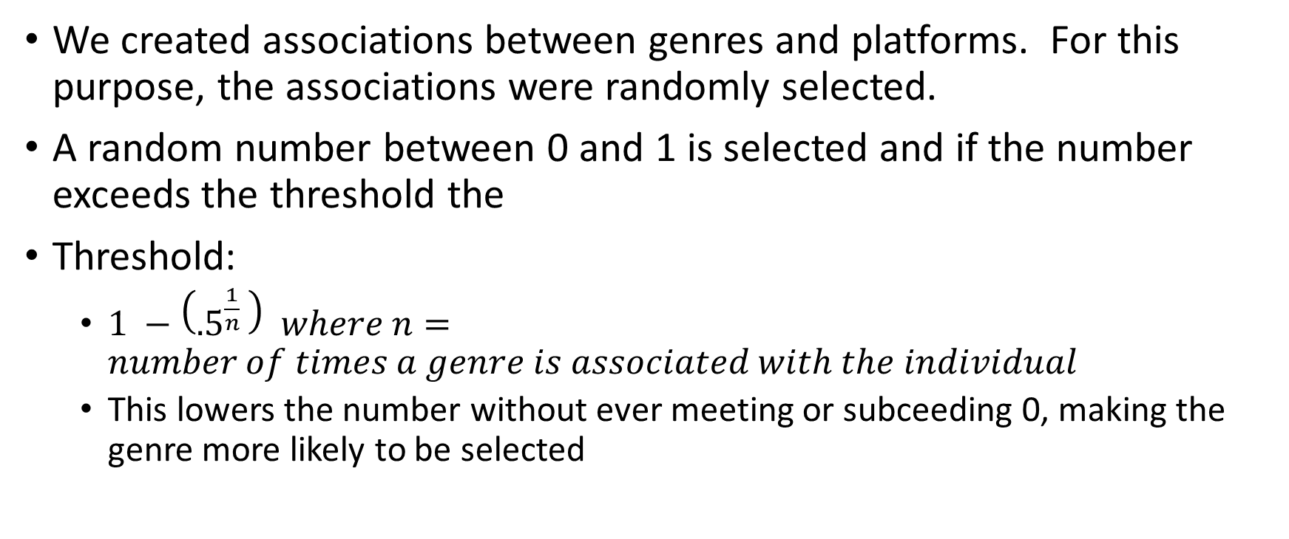
Select genres
We created associations between genres and platforms. For this purpose, the associations were randomly selected.
A random number between 0 and 1 is selected and if the number exceeds the threshold the
Threshold:
$1 −\left({.5}^{\frac{1}{n}}\right) where n=number of times a genre is associated with the individual$
This lowers the number without ever meeting or subceeding 0, making the genre more likely to be selected

